Slide 1


Slide 2

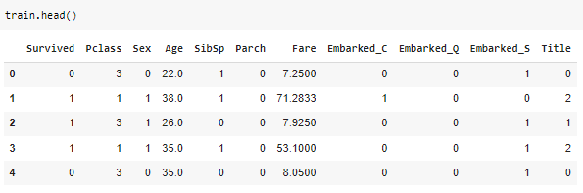
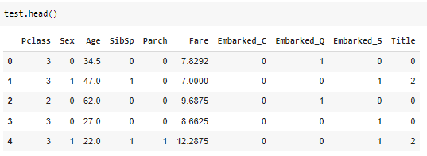
TRAINING
Y
X
TESTING
TESTING
Survived?

Slide 3
Dataset
Training
Testing
Penentuan
Parameter
Evaluasi
Penentuan
Model
Training Validation
Validation

Slide 4
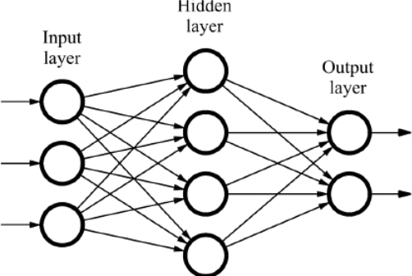
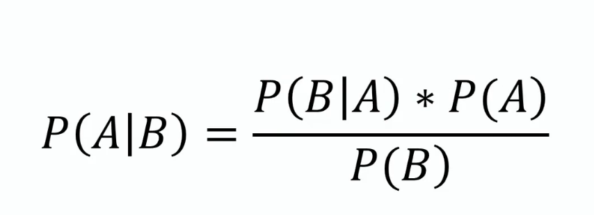
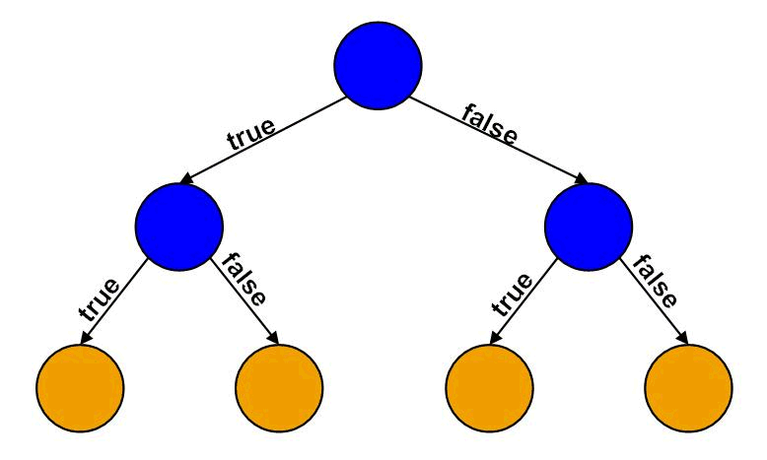
Final Model dan hasil prediksi
Neural Network
Naive Bayes
Decision Tree
Training
Model
Akurasi
Evaluasi
Penentuan
Model
Penentuan
Parameter
source image : https://databricks.com/glossary/neural-network
https://www.analyticsvidhya.com/blog/2021/01/a-guide-to-the-naive-bayes-algorithm/
https://help.sap.com/docs/

